Slide 1
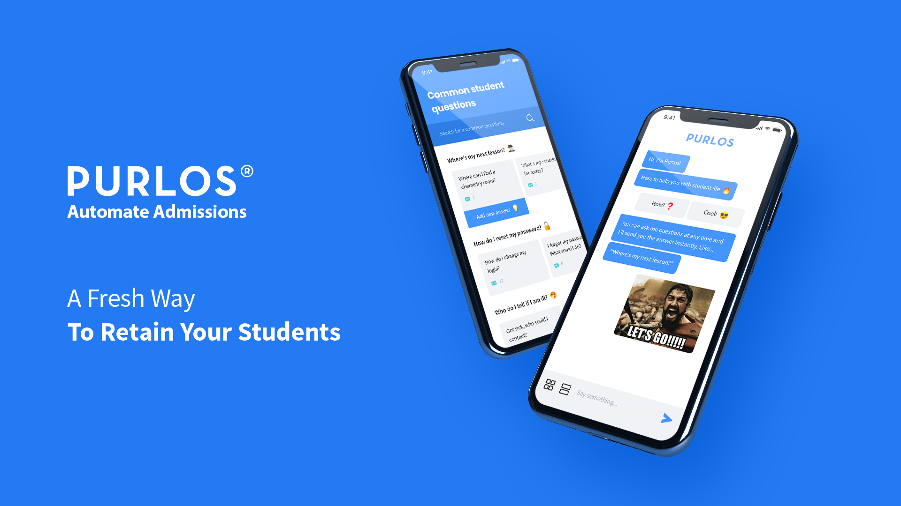

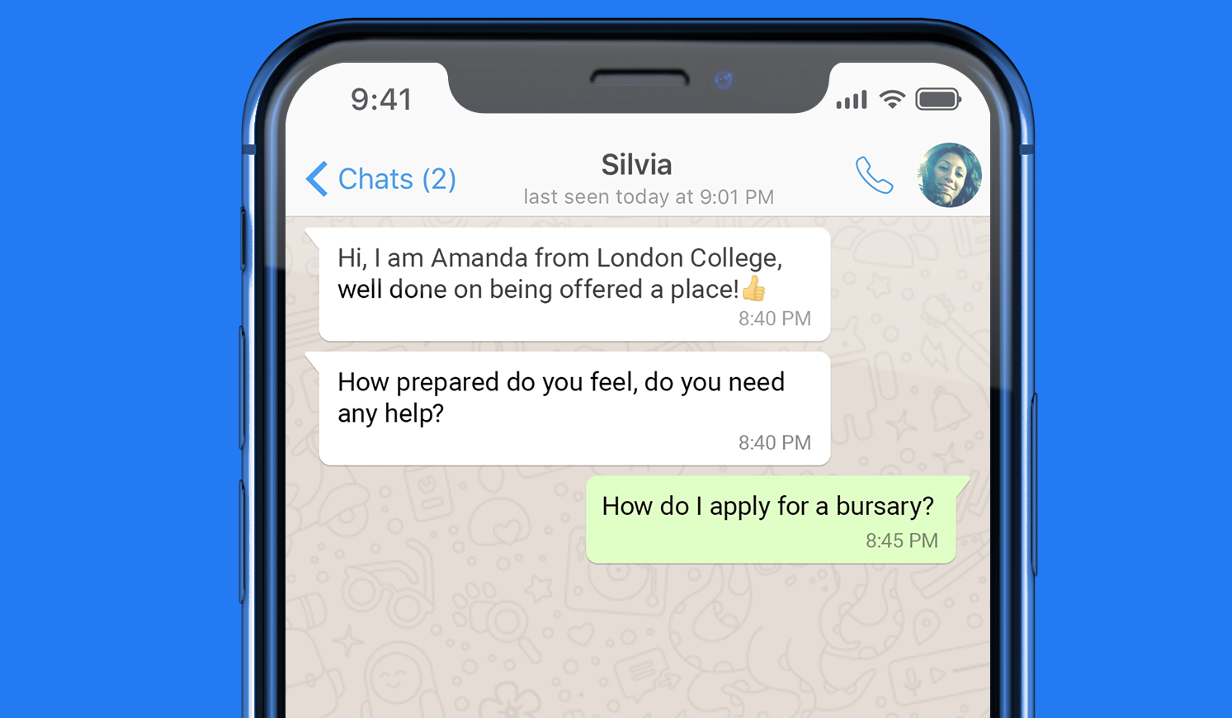


A Fresh Way
To Convert More Students
Some of out clients…

Slide 2



Purlos - Product overview
#1
We use WhatsApp to connect to students during admissions
#2
We answer 80% of admissions questions for you using ‘Human Assisted’ AI
#3
We use analyse data to highlight high risk students during the admissions process and help improve conversions

Slide 3
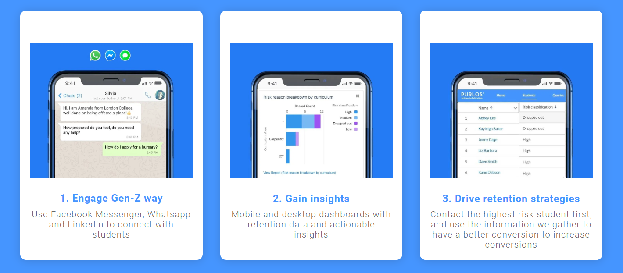
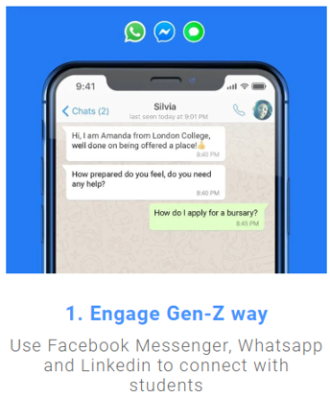
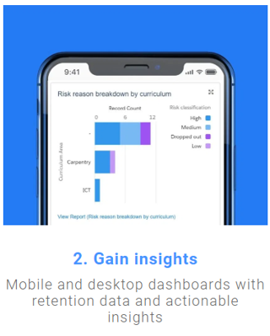
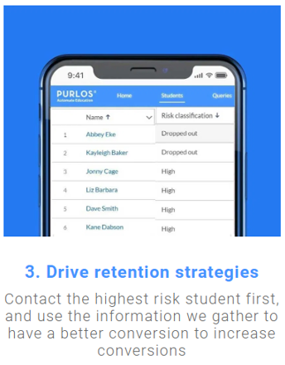
Product:

Slide 4

Client Testimonial
NESCOT has found Purlos’ platform to have a much better engagement level with students compared to existing communications methods. It gives new insights about the highest risk students allowing us to intervene early and support increased conversions.
Engagement with students has been high, about 80% on average
Dario Stevens
Vice Principal , NESCOT

Slide 5
BLC Exclusive Offer
FREE virtual events communications package
for 12 months
(*when bought alongside the admissions platform)
Standard price £1,500 exc. VAT
Quote CODE: BLC2020
*Available for the first 10 colleges before August 31st 2020
Book a demo

