Slide 2






Surviving Contact with Reality
.
Patrick Kelly-Goss
Group AI & Innovation Specialist
Activate Learning
Notes:
Hi, I’m Patrick Kelly-Goss As we know, no plan survives first contact with the enemy; no AI pilot survives first contact with your data, your DPO and your finance director. The promise: this is the path three tools took, and the four problems that nearly killed each. Keep the awards as a quiet footer, not a boast.

Slide 3
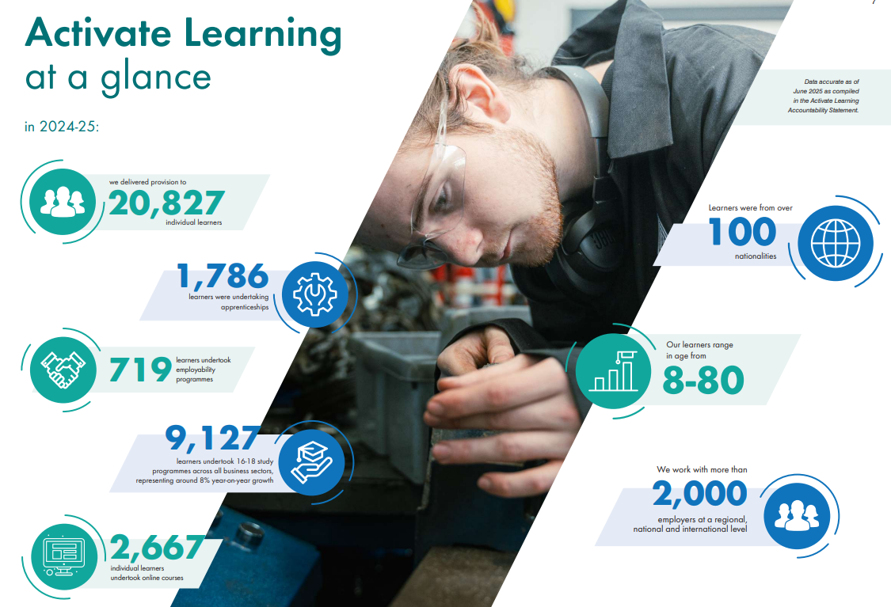


Slide 4

February 2024 Maths AI Tutor introduced to GCSE Maths Online students
March 2024 English AI Tutor introduced to GCSE English Online students
September 2024 AI Maths and English Tutor launched in all GCSE Courses
Sept 2025 AI Tutor Assignment LTI launches
2024 ALIA launched for staff to support with administrative tasks
Jan 2026 EHCP Assistant launched to support accessibility and inclusion
April 2026 Online Conference Coach enters pilot
March 2026 AI Tutor wins AOC Jisc Beacon Award
October 2024 Staff AI feedback assistant launched
Feb 2025 Activate AI wins LPI’s “Best Use of AI in Learning”
Our Journey

Slide 5


THE PILOT GRAVEYARD
Everyone can run a pilot.
Almost no one embeds it.
Raise your hand if you've run an AI pilot this year.
Now keep it up if it's embedded practice across your provision.
For each AI pilot launch
that gets embedded…
02
…19 pilots fail with zero measurable return
(MIT research)
Notes:
Do the show of hands for real. Most hands drop on the second question. Reframe the failure: usually it's not that the tech was bad, it's that nobody could answer four questions well enough to justify scaling.

Slide 6




THE ARGUMENT
Four problems decide whether a pilot becomes practice.
1
2
3
4
Meaningful intent
Data readiness
Governance & GDPR
Proof of impact
Are you building with your users, or throwing something at them?
Does it see all — and only — the right data?
Will sensitive data stay where it should?
Can you show it actually works?
We only earn the right to scale when we can prove it works.
03
Notes:
Name the four problems as the spine of the talk. The fourth — proof — is decisive, because you neither can nor should scale something you can't show works.

Slide 7



Where we’re at
Three pilots, now embedded.
AI Tutor
ALIA
AI Feedback
Feb 2024
Jul 2024
Oct 2024
Learners
Staff assistant
Staff
Not because the AI model was powerful — because each had to survive the same four problems.
39402
83277
15782
72%
AI Tutor conversations
ALIA conversations
submissions analysed
Teaching staff engagement
04
Notes:
Not to do with AI model quality, we actually tend to use cheaper models. We’ve had to in order to maintain under budget!

Slide 8
1
AI Tutor – the pilot intent
Live AI-powered support empowering learners
Life-admin barriers
Blocked learner, unable to access support
Emotional barriers
Additional learning needs
THE GOAL
THE SITUATION
AI TUTOR
Encourages critical thinking
Positive AI use model
Elicits and challenges
Rigorous governance
Tutor transparency
05
Notes:
This is the existential one: an AI 'tutor' could so easily just do the work and erode the thinking it's meant to build.

Slide 9

1
Meaningful intent – the threat
Where it hit hardest — the AI Tutor
THE THREAT
THE PROOF
The initial AI tutor was overly “helpful”. It would fully explain how to answer questions, it would offer grading, it would offer emotional support. AI as the expert in your pocket!
This created a reputational problem with our most important stakeholders: our teachers.
The teacher is the determining factor
Learner take up is almost entirely driven by teacher promotion: the difference in usage rate between most and least engaged classrooms is 30x
Any usage the tool has, it has because teachers value it.
THE FIXES
Re-engineered for a single clear use case: unblocking independent work with “next step only” metacognitive reasoning.
Canvas-focused access pinned the AI tutor to the teacher-set learner journey.
Increased transparency (Canvas SpeedGrader links, conversation monitors) built trust.
05
Notes:
This is the existential one: an AI 'tutor' could so easily just do the work and erode the thinking it's meant to build.

Slide 10
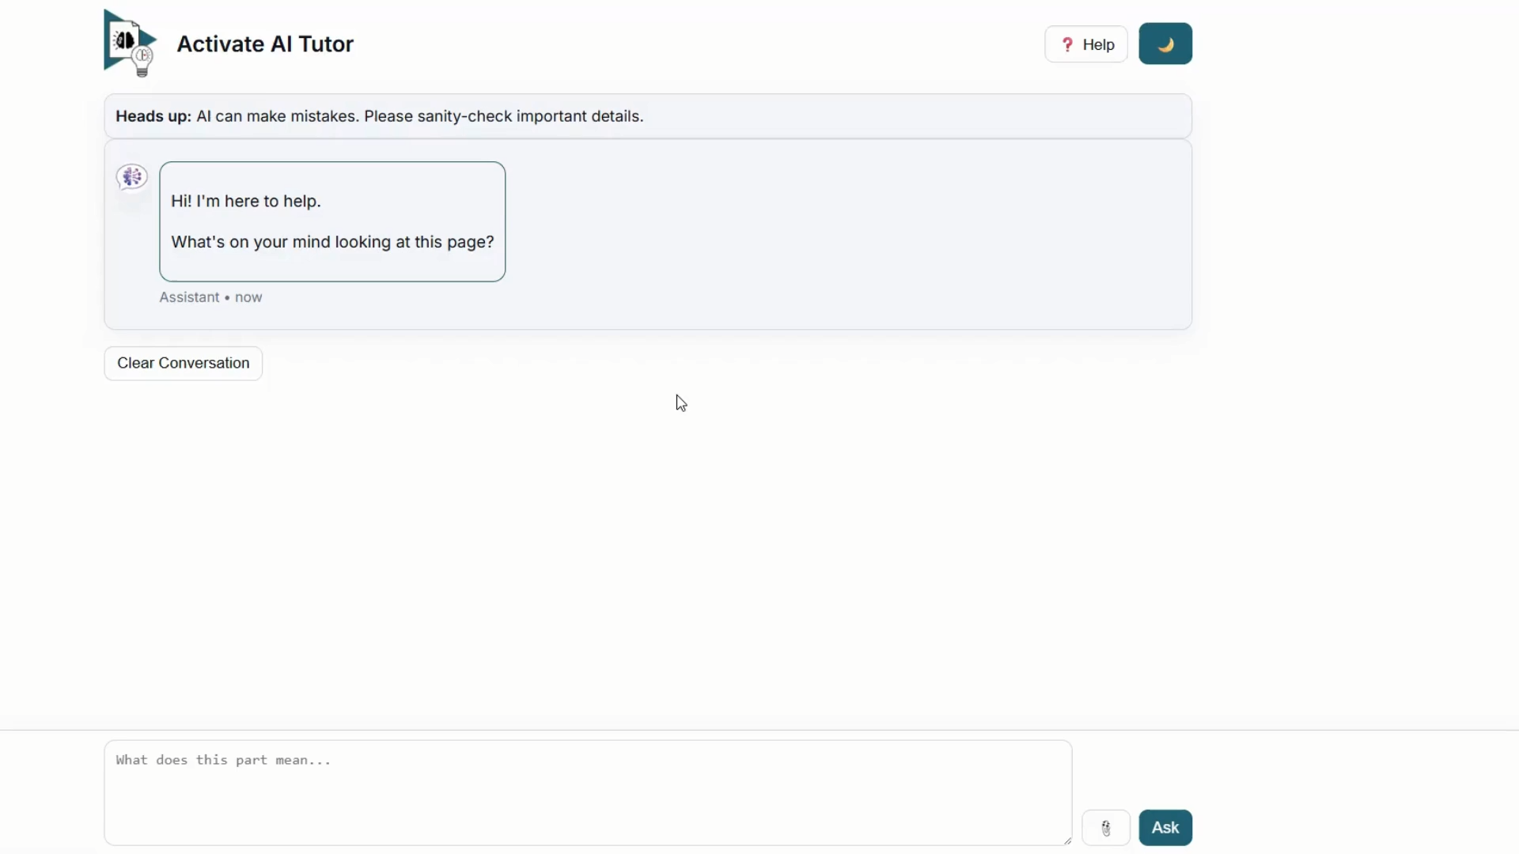
1
Meaningful intent – the result
A tutor with a limited focus

Slide 11

2
ALIA– the pilot intent
An all-purpose AI assistant empowering teaching staff and group services
THE SITUATION
THE GOAL
SharePoint sites
Docs, PDFs
Org website
PowerBI
ProMonitor
REMS (MIS)
Awarding body info
ALIA
Docs, PDFs
Org website
PowerBI
ProMonitor
REMS (MIS)
Awarding body info
SharePoint sites
Data overload means we struggle to find & apply info
Integrated RAG with planning support:
The right information gets applied to the right context.
05
Notes:
This is the existential one: an AI 'tutor' could so easily just do the work and erode the thinking it's meant to build.

Slide 12

2
Data readiness
Where it hit hardest — ALIA
THE THREAT
ALIA was excellent at finding organisational data. The problem: it found too much data. Many keywords have different meanings in different contexts, eg: unionised
Irrelevant organisational data is worse than no organisational data: at least ChatGPT doesn’t pretend to know about your organisation!
No clear mapping between data sources and users; GDPR risks.
THE PROOF
95.7%
of surveyed staff agree ALIA has accurate information. Staff don't return 84,000 times a term to a tool that's confidently wrong.
THE FIX
Canvas as a bootstrap! Course-teacher associations allowed scoping data sources to users: courses, content, learner associations
Subsequently boosted with other data sources to improve fidelity.
06
Notes:
The canonical RAG-data story. INSERT YOUR WAR STORY: an early confidently-wrong answer in front of staff and how data curation fixed it. – with Canvas. Accuracy and quality stats here are from the staff survey across the year.

Slide 13

2
Data readiness – the result
A support agent that knows you and your learners

Slide 14
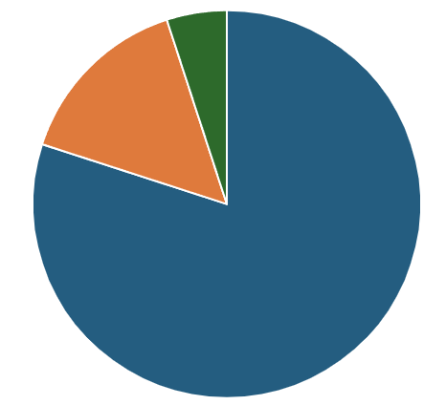
3
AI Feedback Assistant – the pilot intent
Empowering teachers' expertise
THE SITUATION
THE GOAL
FE average: 20% of time spent marking
75% of marking time spent in repetitive work
AI does the repetition
Looks up learner needs
Identifies relevant evidence
Human adds the value
Owns the criteria
Focuses on the relationship
Produces writing frames
Finds requirements
Adds key information
Sets learner for success
05
Notes:
This is the existential one: an AI 'tutor' could so easily just do the work and erode the thinking it's meant to build.

Slide 15

3
Governance & GDPR
Where it bit hardest — the AI Feedback Assistant
THE THREAT
THE PROOF
It touches real submissions and sensitive support needs. “Don’t put personal information into AI” would block moving out of PoC: any learner writing may contain sensitive personal information, and accurate marking requires learner profile information.
15782 submissions
analysed this term:
Genuine learner data, automatically minimised and safely handled by users with legitimate purposes.
THE FIX
Azure AI Foundry models within our governance tenancy
Strict access controls linked to Canvas role
Automatic minimisation and anonymisation of support needs
07
Notes:
The DPO wall. INSERT YOUR WAR STORY: the governance conversation that nearly stopped it, and the anonymisation/RBAC design that unblocked it. The proof of governance is being allowed to run on real, sensitive data at scale at all.

Slide 16
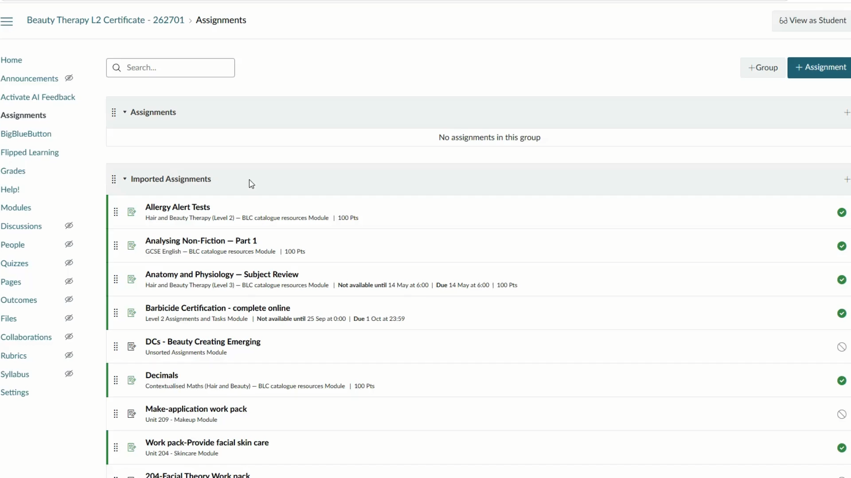
2
Governance & GDPR – the result
Your expertise with AI empowerment

Slide 17
4
Proof of impact
Where it pays off — the AI Tutor
≈ regular use ≈ one-third of a grade
Independent of prior ability and other tools (p ≈ 0.01). Usage is linked to outcomes through Canvas Data 2 — anonymised, per learner and course.
Effect on grade improvement (logarithmic, each 10x increase of usage)
regression coefficients · all p < .05
REACH — NOT JUST RESULTS
2×
more use by learners with exam access arrangements
>80%
of those who try it keep using it
89%
want to use it more
08
Notes:
The centrepiece. Lead with the headline: ~10 uses worth a third of a grade, holding prior ability, engagement and other tools constant (p≈0.01). GUARD THE CONFLATION: EAA learners USE the tool more (an inclusion finding); having an EAA does NOT predict improvement in the regression — two different analyses. Let one chart breathe; don't parade every coefficient.

Slide 18

WHAT ACTUALLY SURVIVED
It wasn't the model.
Every fix leaned on the same thing: a curated, governed, measurable data layer underneath. For us, that's Canvas.
Data readiness
Governance
Proof of impact
curated & consistent
anonymised & role-scoped
linked & measurable
Building on strong foundations gives you a stronger product.
09
Notes:
Notice the fixes had little to do with the LLM. Each survival leaned on a curated, governed, measurable data layer. For us that's Canvas — anonymisation, RBAC, SSO, Canvas Data 2. Then generalise immediately so it isn't a Canvas advert: you need these properties wherever learning lives.

Slide 19

TAKE THIS HOME
A test for any AI tool.
Meaningful? Does it support learning, or replace the thinking?
Data-ready? Does it see all — and only — accurate, relevant data?
Governable? Can you prove it won't leak sensitive data?
Evidenceable? Can you link its use to real outcomes?
10
Notes:
Hand the room the four problems as a rubric for judging any AI tool — their own, a vendor's (several are in the room), or a roadmap feature like Ignite AI. This is the practical gift, and it's diplomatically perfect: you help them evaluate, not compete.

Slide 20
AI hurts learners when it thinks for learners.
Does your pilot help them think for themselves?
11
Notes:
Callback to the meaningful-usage design and the inclusion evidence. The goal was never AI that thinks for learners; it's AI proven to help them think, and proven to reach those who most need it.

Slide 21
DIGITAL, TOGETHER
This shouldn't be a lottery.
Embedded, evidenced, governed AI can be a shared FE capability — not a privilege of the best-resourced colleges.
That's the invitation.
12
Notes:
The call to action, aligned to the conference theme. None of this should be a lottery between resourced and under-resourced colleges; the consortium model means embedded, evidenced, governed AI can be shared.

Slide 22
ACTIVATE LEARNING
DIGITAL
Questions?
Patrick Kelly-Goss
digital@activatelearning.ac.uk
AOC Beacon Award · Jisc Effective Use of Technology 25/26 · Learning Awards Gold
Notes:
Contact and questions. If you have a workshop-feedback QR, drop it on the right here.

