Slide 1
BLC Co‑Lab:
Digital Together
Where FE communities learn, share and grow

Slide 2
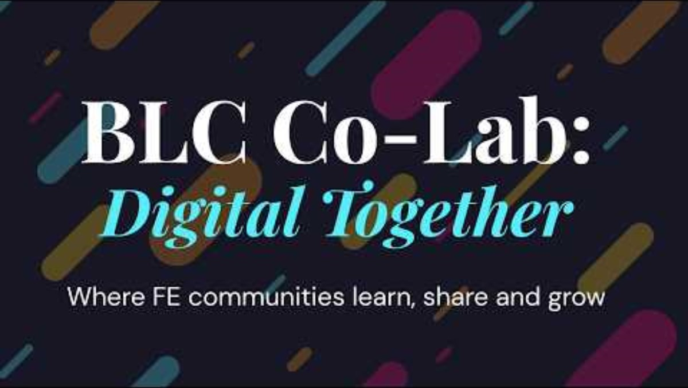

Slide 3
BLC Co‑Lab:
Digital Together
Where FE communities learn, share and grow

Slide 4
Welcome!

Slide 5










Thank you to our sponsors and supporters!

Slide 6
Housekeeping and Safety

Slide 7
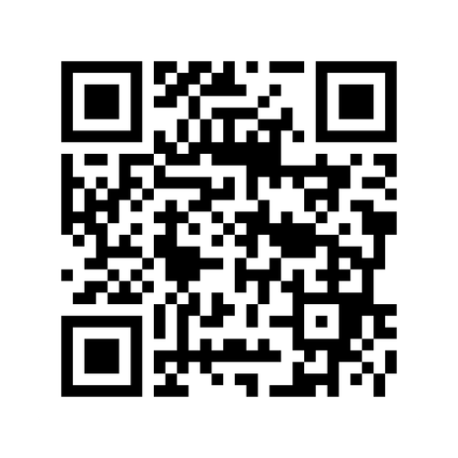
Got a question?
https://canva.link/BLCConf26Questions
BLC Co‑Lab:
Digital Together

Slide 8
Today’s Agenda
This morning’s sessions...
BLC Welcome
Instructure and Activate Learning
Taskmaster Education
Close at Artrix
Sponsors’ stands and lunch
10:10
10:40
11:10
11:40
12:00
- 10:40
- 11:10
- 11:40
- 12:00
- 13:00
BLC Co‑Lab:
Digital Together

Slide 9
Today’s Agenda
This afternoon’s sessions...
Workshop stream 1
Workshop stream 2
Workshop stream 3
Event close
13:15
13:50
14:25
15:00
- 13:45
- 14:20
- 14:55
BLC Co‑Lab:
Digital Together

Slide 10
BLC Welcome and Updates

Slide 11
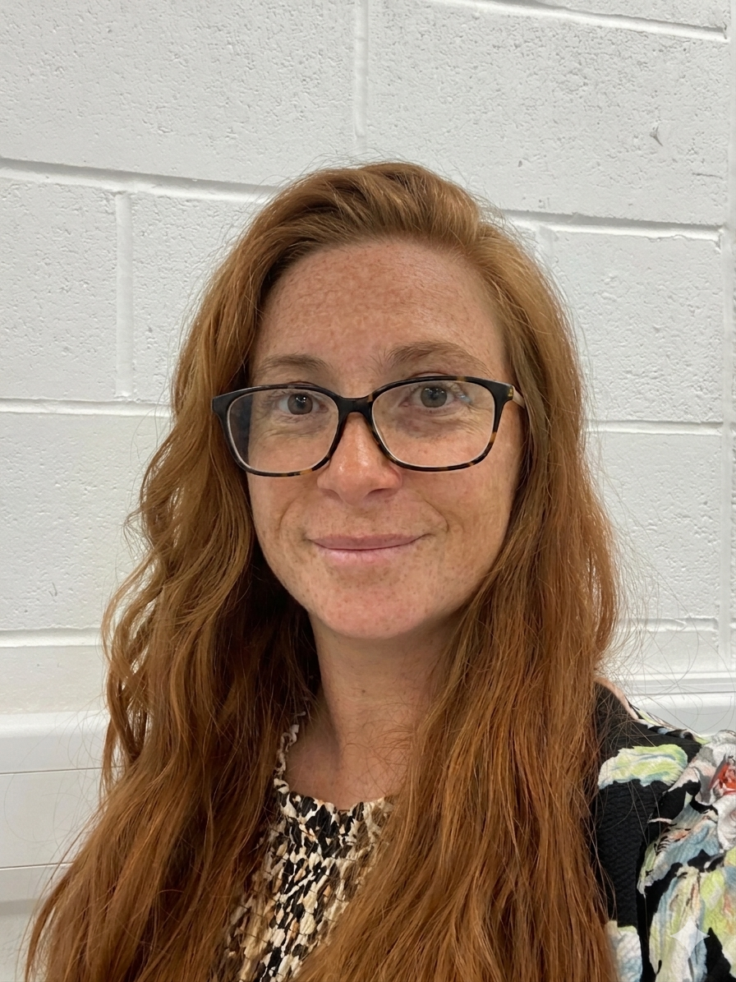

Introducing...
Kirsty Cullen
Digital Learning Manager
Blended Learning Consortium and HoW College

Slide 12
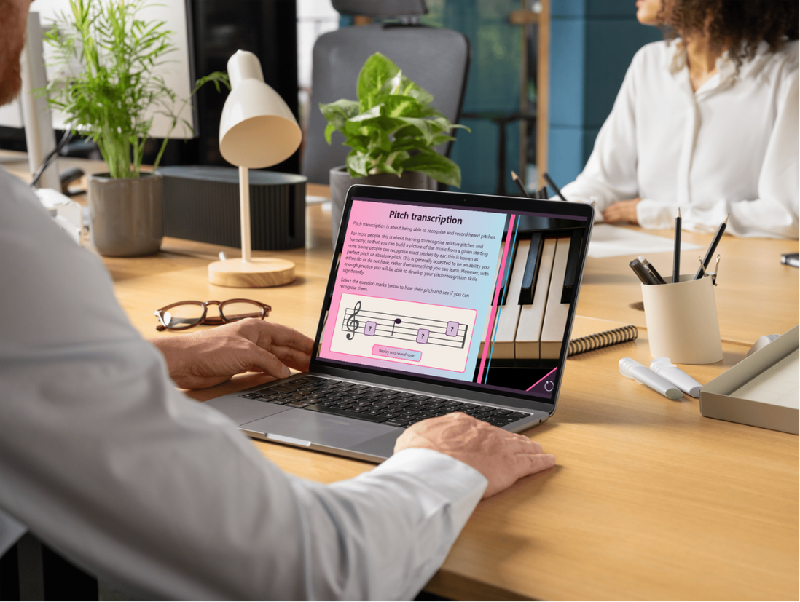
Phase 10 Update
328 resources across 7 subjects
  Personal Development
  Construction
  Criminology
  Music and Music Production
  Digital Skills (refresh)
  Maths L1 (refresh)
  English L2 (refresh)

Slide 13
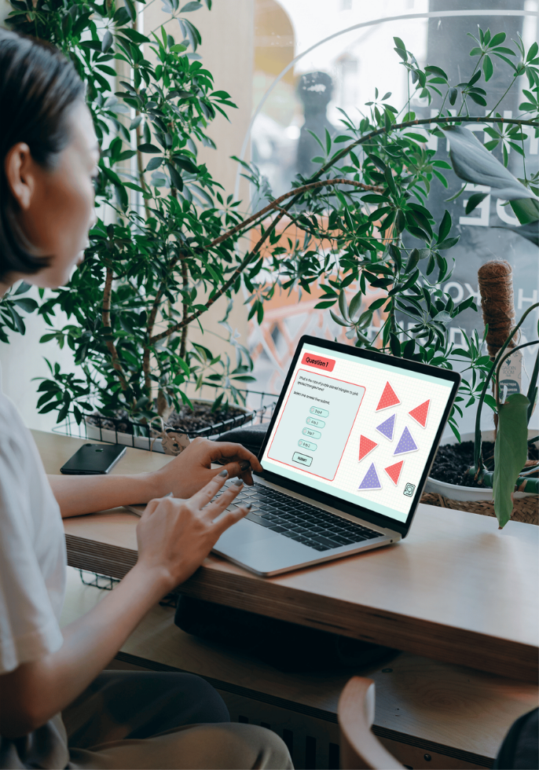
Phase 10 Update
Resource types include:
  Storyline and Rise sessions
  Microlearning sets
  Standalone apps
  Specialised interactive elements
  Videos
  Podcasts
  Interactive scenarios

Slide 14
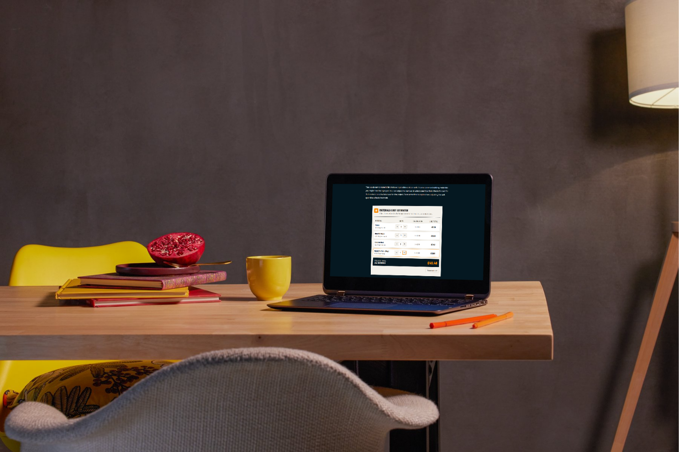
Phase 10 Releases
Fully released subjects:
  Personal Development
  Digital Skills
  Criminology
  Music and Music Production
  English L2
  Maths L1
Construction L1 being released next

Slide 15
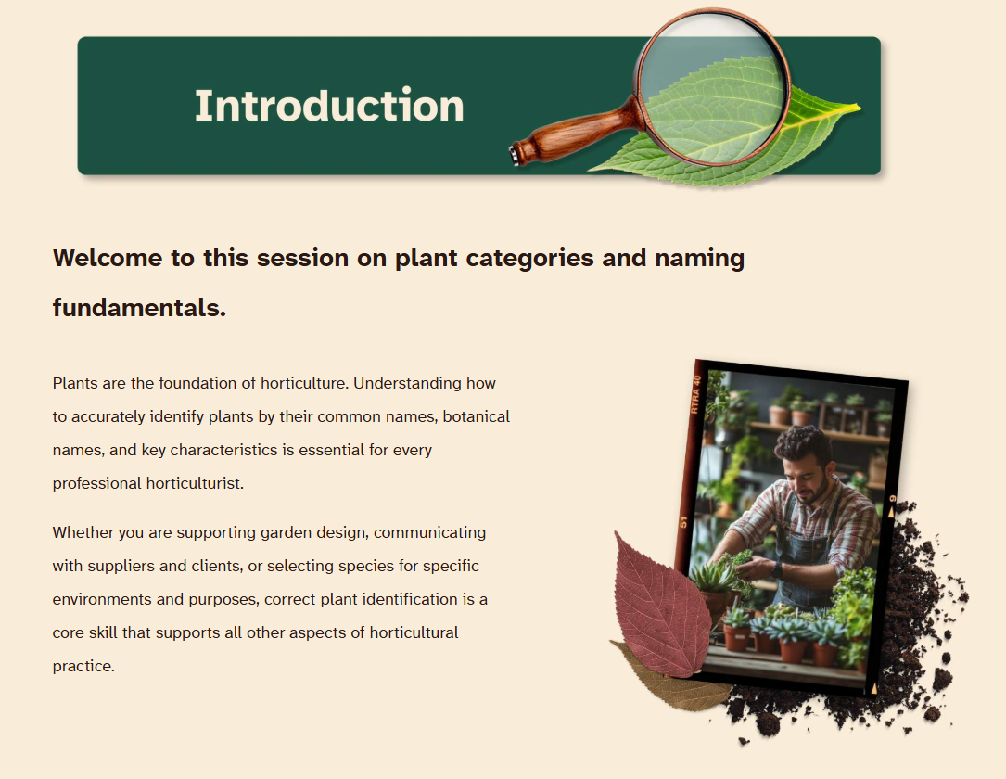

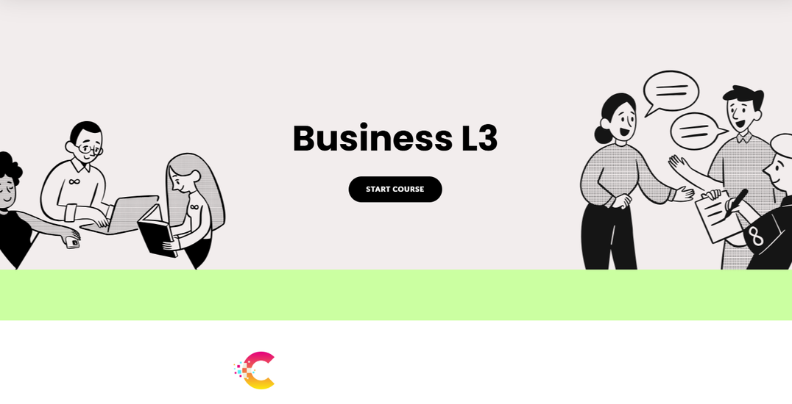
Phase 11 Update
Approximately 200 new resources across:
  Science L2 and L3
  Travel and Tourism L2 and L3
  Horticulture and Floristry
  Art and Design
  Business L3

Slide 16
What’s new?

Slide 17
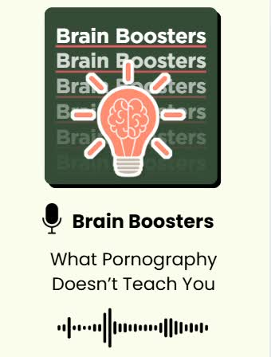
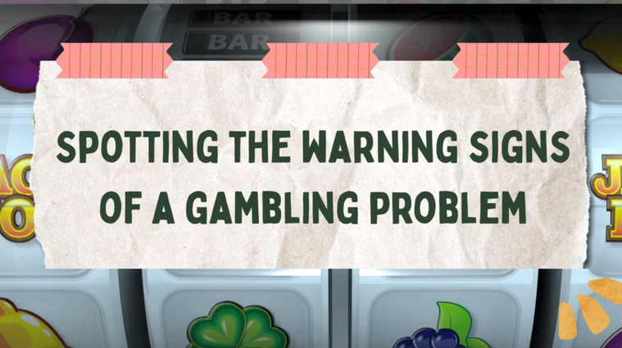

New! Personal Development Package
The BLC Personal Development and Wellbeing Package
gives tutors or facilitators everything they need to walk
into any of their tutorials with confidence.
No blank slide decks, no hours of research. Just open our resources, adapt if you want to to suit your group, and teach.
Designed and curated by teachers, for teachers.
31 topics across three progressive levels with every session provided as a complete teaching pack.
Separate from our eLearning resources to cover all delivery and learning options.

Slide 18
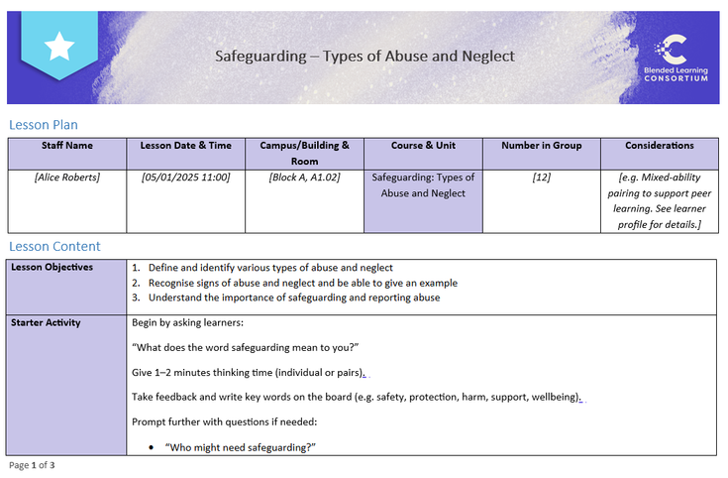

New! Personal Development Package
1-hour lesson
A structured face-to-face session ready to deliver without any additional preparation
PowerPoint & worksheets
Fully editable slide decks and supporting worksheets to adapt for your learners
Video content
Engaging video resources to complement and extend the classroom session
Editable lesson plan
A pre-built lesson plan you can tailor to your context, saving hours of prep time

Slide 19
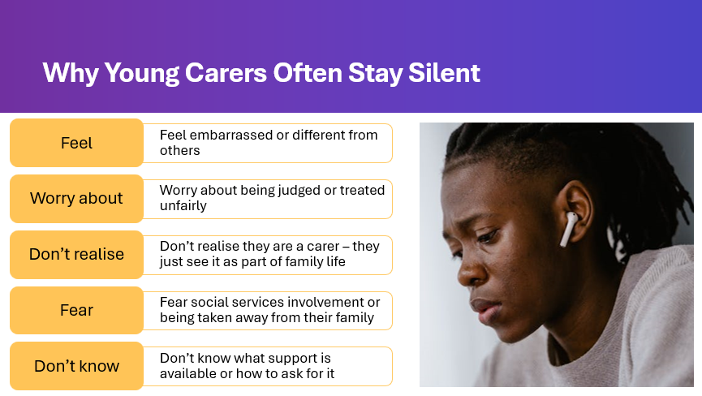

Personal Development Package
Launch Webinar
Thursday 9th July
10am - 11am
Join us for a showcase
of the new personal development resources including how to purchase and access.

Slide 20
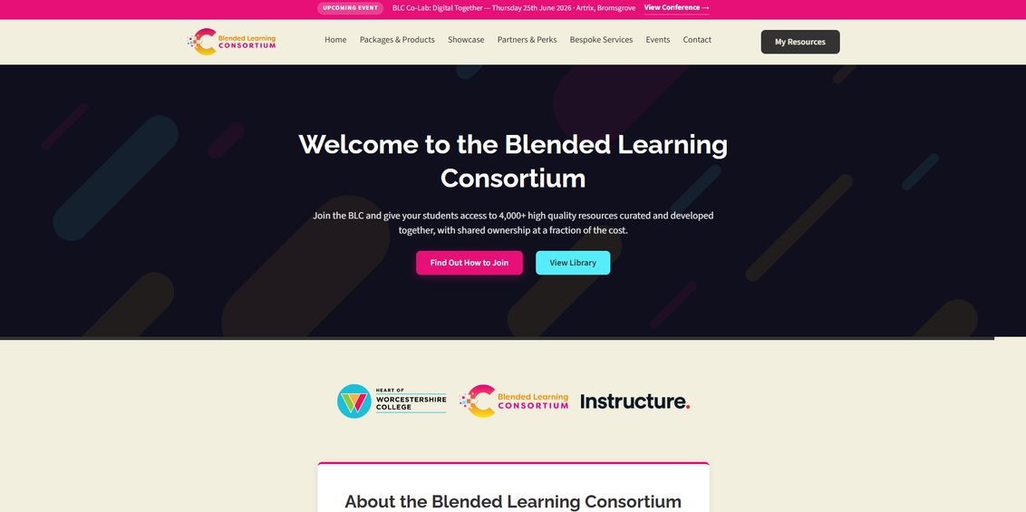

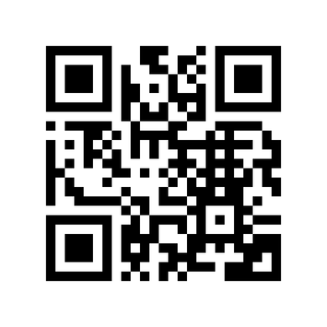
New! BLC Website
Brand new in-house build to suit our customers and our BLC future offers
Customer focused experience to give you quick access to your resources
Seamless links to past and future BLC events and communications
Access to new and exclusive offers from a range of sector providers
Bespoke services to new and current customers
Clear showcase of our resources, partner offers and customer feedback

Slide 21
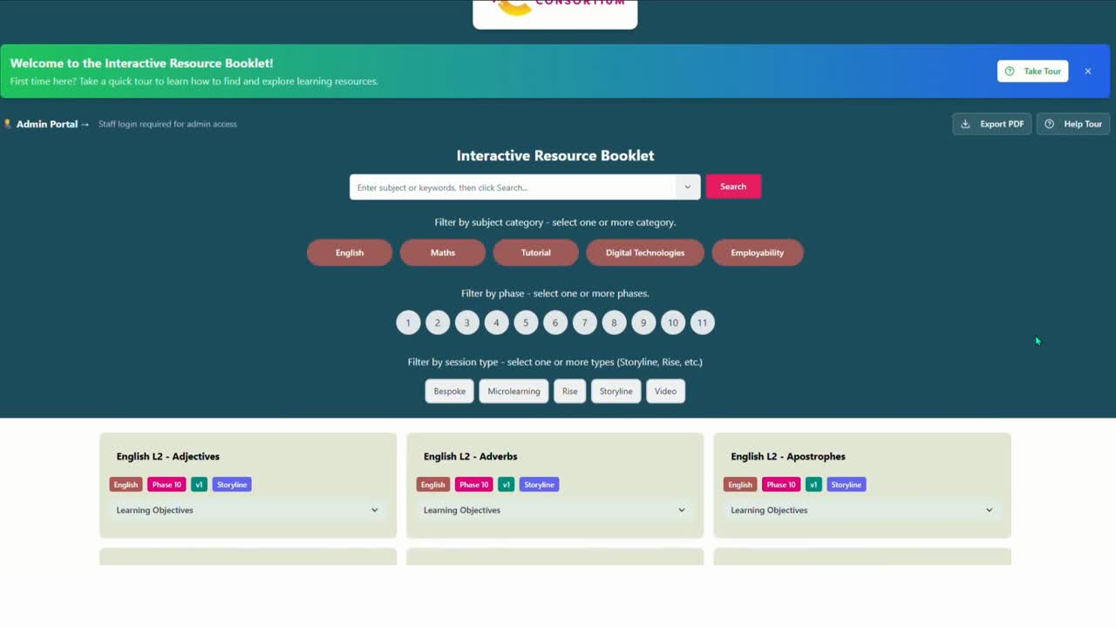
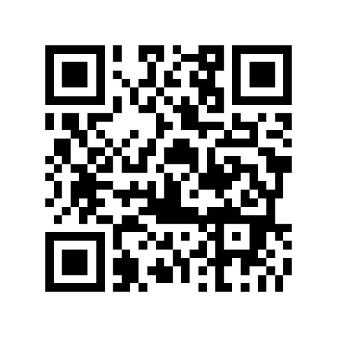
New! Resource Booklet
Focusing on customer experience
Easily search across all subjects, packages and resources
Previews to be built into each subject from each phase for easy browsing
Downloadable PDFs to focus on your planning and development with our resources

Slide 22




The BLC’s Future
Customer hub linked to our website to access resources easier
Exciting new developments with ‘BLC Connectors’ to sector-leading VLEs
Customer focused partnerships:
XR Catalogue with Activate Learning / AR Resources with South Staffs
Personal Development Package offer to support those wonderful tutorials!
eLearning
Resources
Personal Development Packages
XR Catalogue and
BLC Connectors
Bespoke
Services

Slide 23
Q & A

Slide 24
BLC Welcome and Updates

Slide 25
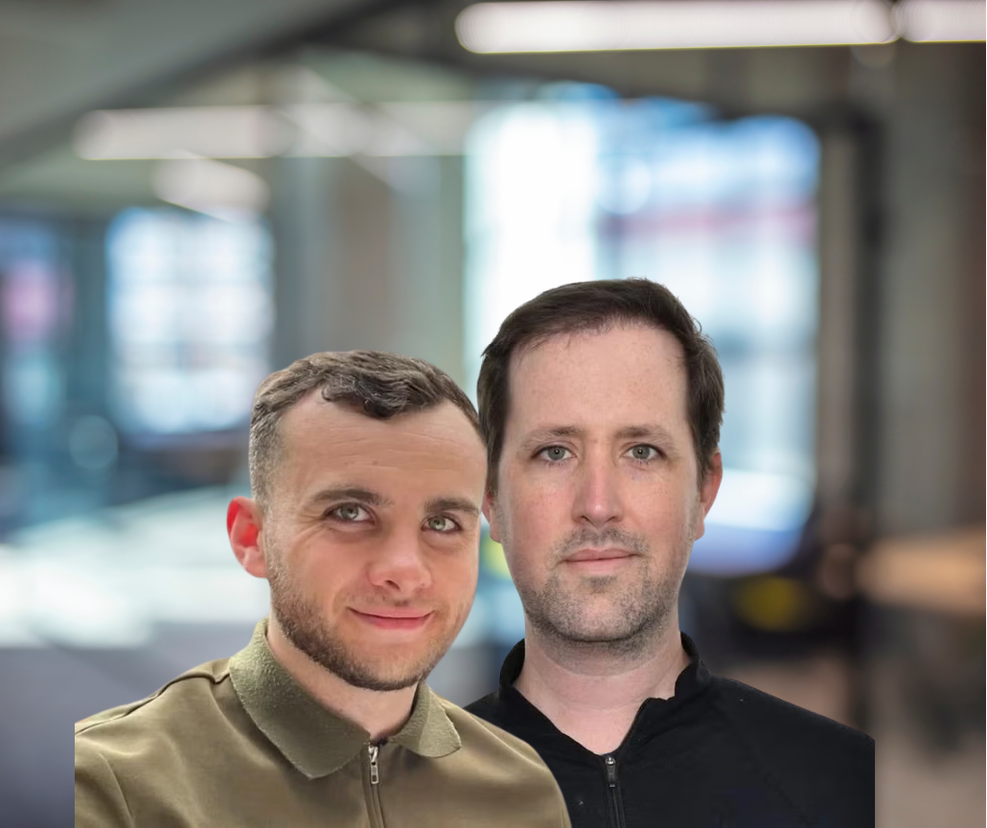

Up next...
Matthew McShane & Patrick Kelly-Goss
Instructure & Activate Learning
Real AI: Surviving Contact with Reality
Notes:
We need to have Matthew McShanes's headshot on here Sarah. Plus a way of having Instrucutre and Activate Learning's logos please. 🙏🏻

Slide 26
Q & A

Slide 27
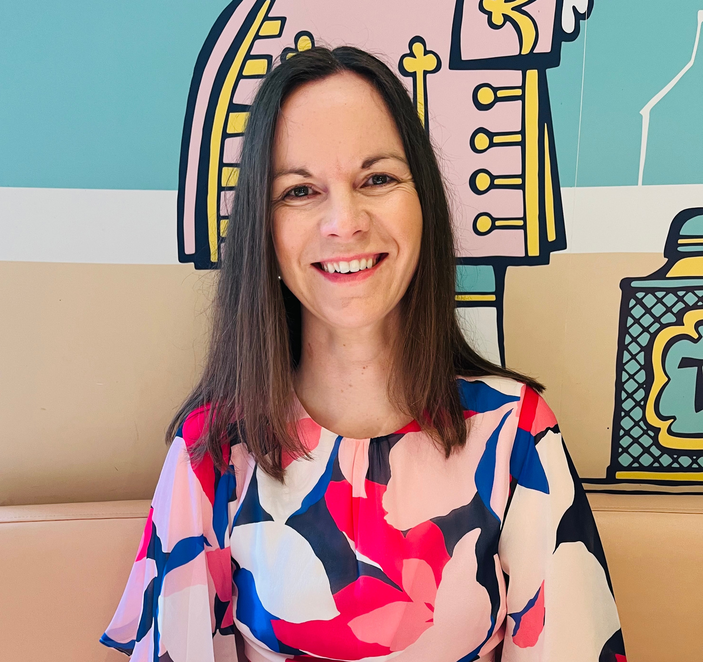
Up next...
Dr Ali Struthers
Taskmaster Education
The Taskmaster Approach to Creativity

Slide 28
Q & A

Slide 29
Morning Close

Slide 30
Today’s Agenda
This afternoon’s sessions...
Workshop stream 1
Workshop stream 2
Workshop stream 3
Event close
13:15
13:50
14:25
15:00
- 13:45
- 14:20
- 14:55
BLC Co‑Lab:
Digital Together

Slide 31
BLC Co‑Lab:
Digital Together
Where FE communities learn, share and grow

